Slide 1




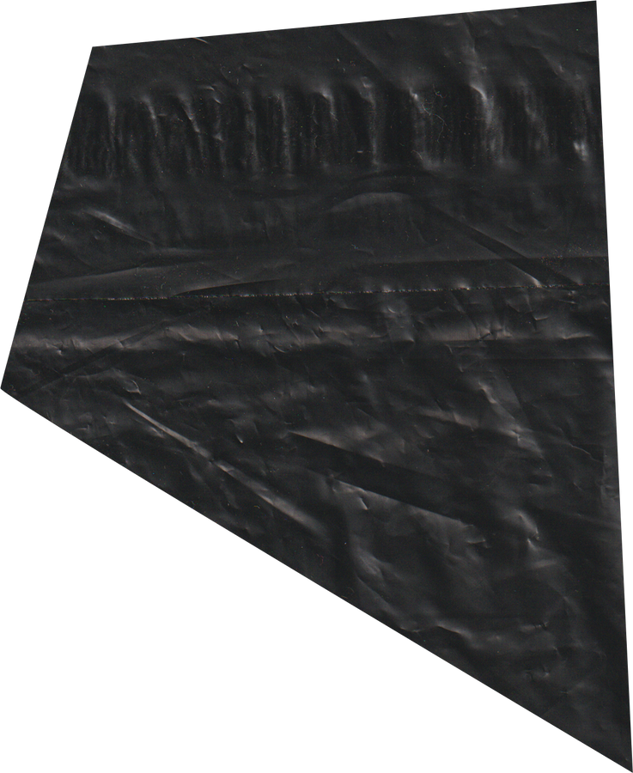


JAMEL P. HADJIRASUL
BSCPE - 2
CPE262
PROJECT PRESENTATION
PPT FROM CANVA.COM
PARKEASE
PARKEASE

Slide 2
JAMEL P. HADJIRASUL
PROJECT DESCRIPTION
ParkEase is a parking reservation and management system that simplifies the process of finding and securing parking spaces. Users can effortlessly browse available spots and select based on preferences. By integrating this system into the parking experience, ParkEase transforms the frustrating task of parking into a smooth, hassle-free process for both drivers and parking facility operators.
PARKEASE
1/10

Slide 3



JAMEL P. HADJIRASUL
PURPOSE AND OBJECTIVES
ENHANCE THE EFFICIENCY OF PARKING LOT OPERATIONS
STREAMLINE PARKING
RESERVATION SYSTEM EXCLUSIVELY FOR EMPLOYEES
PARKEASE
2/10

Slide 4
JAMEL P. HADJIRASUL
FUNCTIONALITIES
1
SIGNUP / LOGIN
4
PAYMENT OPTIONS
2
PARKING SPOT OCCUPANCY
5
ADMIN MANAGEMENT SYSTEM
3
EMPLOYEE RESERVATION
PARKEASE
3/10

Slide 5


ADMIN
DRIVERS
USERS
PARKEASE
4/10

Slide 6
JAMEL P. HADJIRASUL
STEP 1
STEP 2
STEP 3
STEP 4
Users must first register or create an account to generate a user ID
Users will select and occupy their preferred parking spot by inputting their user ID
After occupying a parking spot, a ticket number will be generated
The user will check out after selecting a mode of payment, and the program will generate a receipt
USERS
PARKEASE
5/10

Slide 7
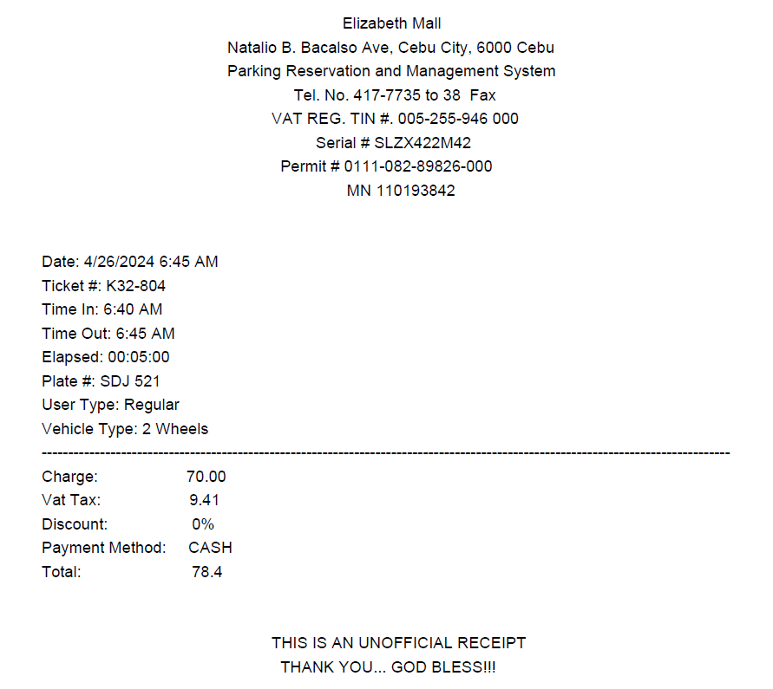
RECEIPT
TICKET #
SD
K32 - 804
PARKING CODE
LAST 3 DIGITS OF USER’S ID
PARKEASE
6/10

Slide 8
JAMEL P. HADJIRASUL
USER AND EMPLOYEE DATBASE
PARKING LOG
SALES REPORT
The admin can view the current status of parking and manage onsite payments and
The admin can view the sales report or the total parking fee for a specified date
Only the admin can create accounts for employees
ADMIN
PARKEASE
7/10

Slide 9
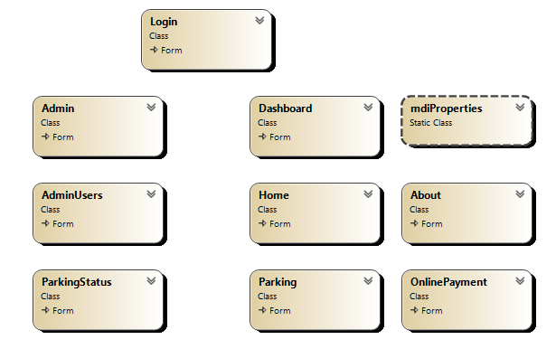
CLASS DIAGRAM
PARKEASE
8/10

Slide 10
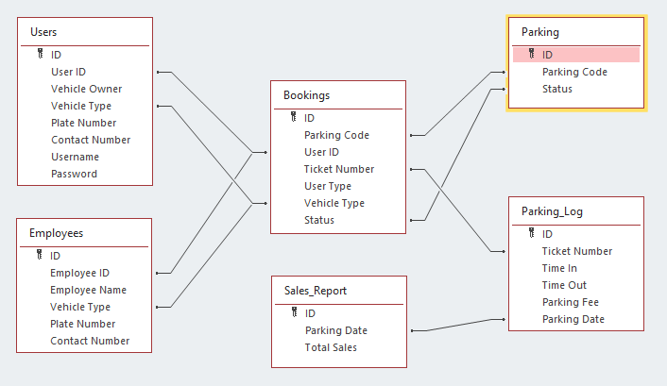
ERD
PARKEASE
9/10

Slide 11
JAMEL P. HADJIRASUL
BSCPE - 2
THANK YOU
PARKEASE
10/10
PPT FROM CANVA.COM

